Slide 1
נ.נ. בתכנון משולב חומרה/תוכנה אביב – 00460882 תרגול 1 Intro to perf -
אוהד איתן

Slide 2
Administrative
Grades:
HW1 (10%)
HW2 (15%)
Final Project (75%)

Slide 3
Technical
Moodle
Slides would be available before the class
You are allowed to use AI.
However, it is up to you to understand the subject very well

Slide 4
Technical
Moodle
Slides would be available before the class
You are allowed encouraged to use AI.
However, it is up to you to understand the subject very well

Slide 5
Assistance
By email (personal)
Moodle Forum (public)
Last year there were around 24 students…

Slide 6
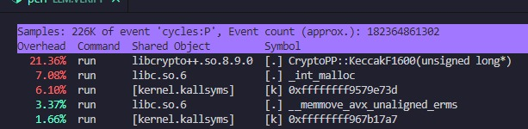
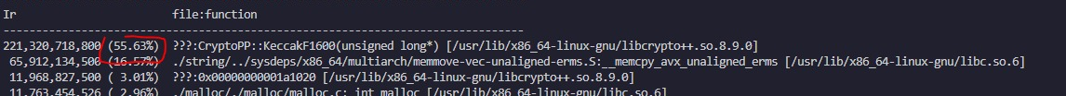
My Motivation
Profiling tools: Valgrind, gprof, htop

Slide 7
Motivation
Application Server
Application
Virtual Machine
Operating System
Hardware

Slide 8
Disclaimer
Software and Hardware are complex (solve complex problems).
Software-Hardware are difficult to comprehend.
Application usage scenario is hard to predict.

Slide 9
Introduction to Profiling
Profiling is the first step in optimizing and tuning your application.
Profiling an application helps you understand where most of the execution time is spent.
Profiling enables you to find hotspots and bottlenecks in your application so you can decide where to focus your optimization efforts.

Slide 10
Qualities of a great profiler
Accurate
Low-overhead
Fast convergence
Flexible
Portable
Transparent
Low storage overhead

Slide 11
Perf
perf (Performance Counters for Linux) is a powerful profiling and performance analysis tool included in the Linux kernel.
It allows developers and system administrators to measure and analyze various performance metrics of applications and the entire system.

Slide 12
With perf, you can:
Analyze CPU usage and detect bottlenecks.
Profile functions and identify hotspots in programs.
Measure cache misses, branch mispredictions, and other low-level performance metrics.
Trace system calls and context switches.

Slide 13
The Power of perf
Built-in Kernel Support: No need for external installations.
Low Overhead: Minimal impact on system performance.
Comprehensive Data: Provides both hardware and software performance metrics.
Versatility: Can be used for high-level system monitoring or low-level CPU analysis.

Slide 14
Intro to perf
Checking if perf is installed
perf --version

Slide 15
Intro to perf
Installing perf:
sudo apt install linux-tools-common linux-tools-$(uname -r)
If everything is right:

Slide 16
The perf tool offers a rich set of commands to collect and analyze performance and trace data. The most common ones are: stat, record, report.
stat Run a command and gather performance counter statistics
record Run a command and record its profile into perf.data
report Read perf.data (created by perf record) and display the profile

Slide 17
Events
The perf tool supports a list of measurable events, coming from different sources.
For instance, some event are pure kernel counters, in this case they are called software events. Examples include: context-switches, minor-faults.
Another source of events is the processor itself and its Performance Monitoring Unit (PMU).
It provides a list of events to measure micro-architectural events such as the number of cycles, instructions retired, L1 cache misses and so on.
Those events are called PMU hardware events or hardware events.

Slide 18
cpu-cycles OR cycles [Hardware event]
instructions [Hardware event]
cache-misses [Hardware event]
branch-instructions OR branches [Hardware event]
branch-misses [Hardware event]
cpu-clock [Software event]
page-faults OR faults [Software event]
minor-faults [Software event]
major-faults [Software event]
context-switches OR cs [Software event]
cpu-migrations OR migrations [Software event]

Slide 19
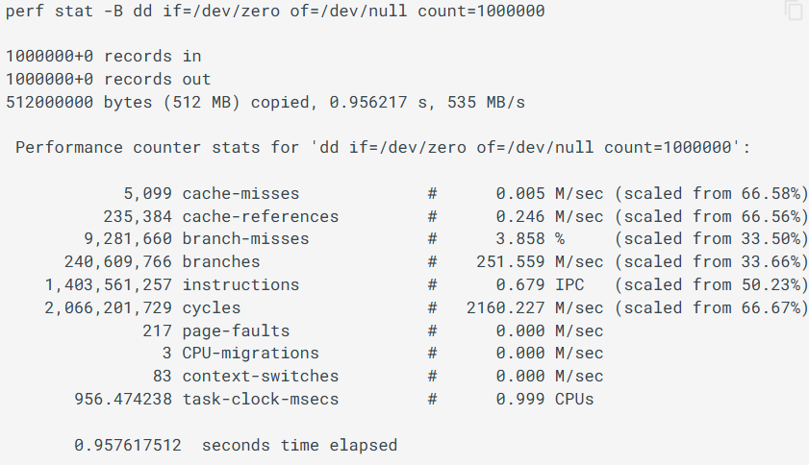
For any of the supported events, perf can keep a running count during process execution.
In counting modes, the occurrences of events are simply aggregated and presented on standard output at the end of an application run.
To generate these statistics, use the stat command of perf. For instance:

Slide 20
The perf tool can be used to count events on a:
per-thread
per-process
per-cpu
In per-thread mode, the counter only monitors the execution of a designated thread.
When the thread is scheduled out, monitoring stops.
When a thread migrated from one processor to another, counters are saved on the current processor and are restored on the new one.

Slide 21
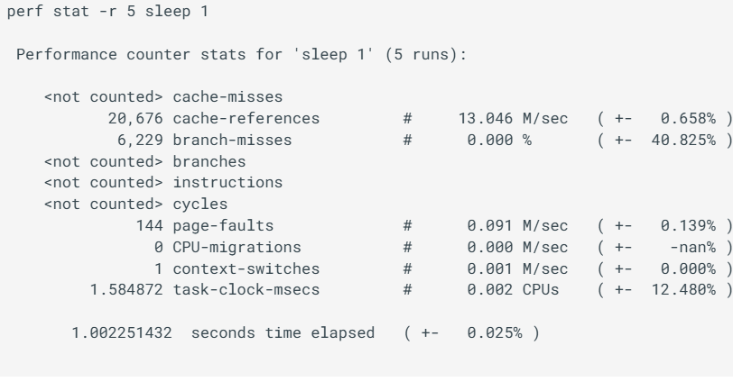
Repeated measurement
It is possible to use perf stat to run the same test workload multiple times and get for each count, the standard deviation from the mean.
Here, sleep is run 5 times and the mean count for each event, along with ratio of std-dev/mean is printed.

Slide 22
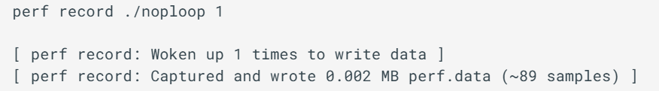
Sampling with perf record
There are several commands associated with sampling: record, report, annotate.
You must first collect the samples using perf record.
This generates an output file called perf.data.
That file can then be analyzed, possibly on another machine, using the perf report and perf annotate commands.

Slide 23
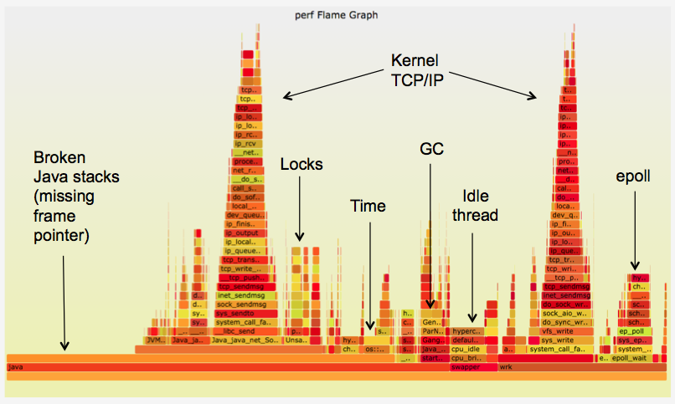
Flame Graph
FlameGraphs are a popular way to visualize stack traces and break down execution time. The perf tool supports natively generating flame graphs using the perf script report flamegraph command.
perf record -a -g -F 99 sleep 60
perf script report flamegraph
google-chrome flamegraph.html

Slide 24
Callchains
The overhead can be shown in two columns as 'Children' and 'Self' when perf collects callchains.
The 'self' overhead is simply calculated by adding all period values of the entry - usually a function (symbol).
The sum of all the 'self' overhead values should be 100%.
The 'children' overhead is calculated by adding all period values of the child functions so that it can show the total overhead of the higher level functions even if they don't directly execute much.
'Children' here means functions that are called from another (parent) function.

Slide 25
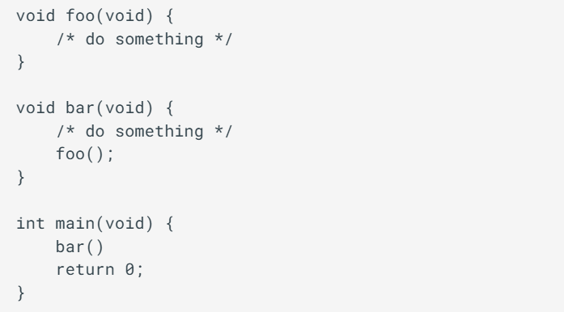
In this case 'foo' is a child of 'bar’, and 'bar' is an immediate child of 'main' so 'foo' also is a child of 'main'. In other words, 'main' is a parent of 'foo' and 'bar', and 'bar' is a parent of 'foo'.

Slide 26
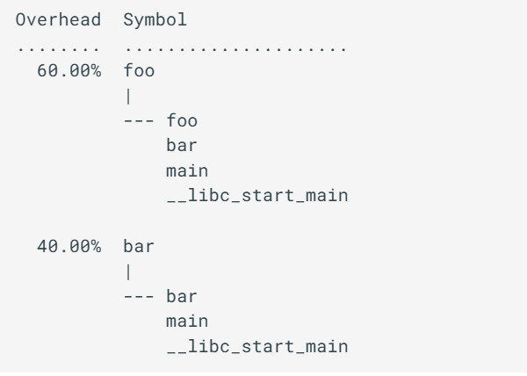
Suppose all samples are recorded in 'foo' and 'bar' only. When it's recorded with callchains the output will show something like below in the usual (self-overhead-only) output of perf report:

Slide 27
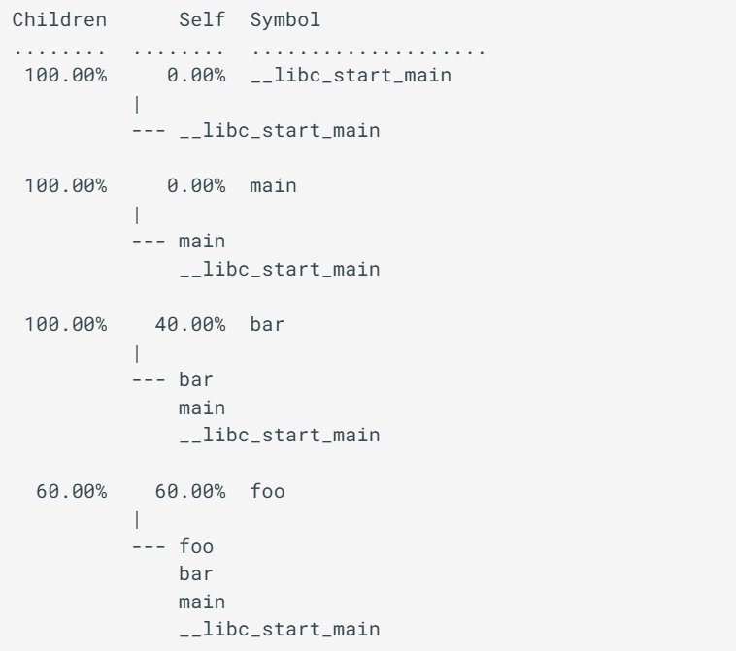

Slide 28
Acknowledge
Some Ideas and sildes, were taken from the internet, special thanks to:
Suyog K Sethia
https://www.brendangregg.com/perf.html
https://perfwiki.github.io/main/tutorial/

